Slide 1

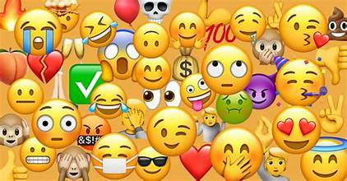
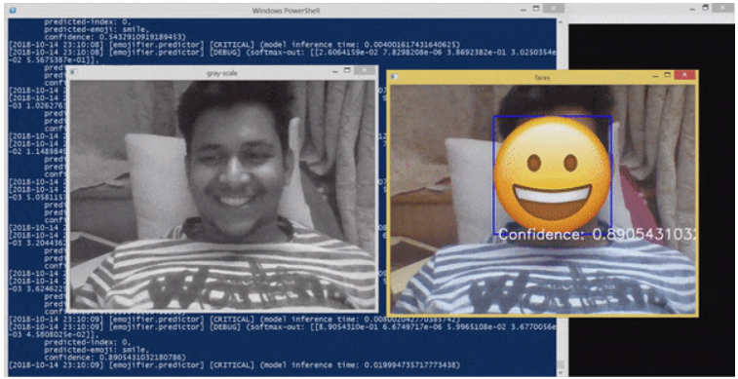
EmojiKids Designed to help parents and caregivers understand a child's emotional state
Hannah Baker
Kayla Adams
Maryann Mugo
Dalisia Brown

